Slide 1




TEAM 30
HACKTOBERFEST 1.0

Slide 2



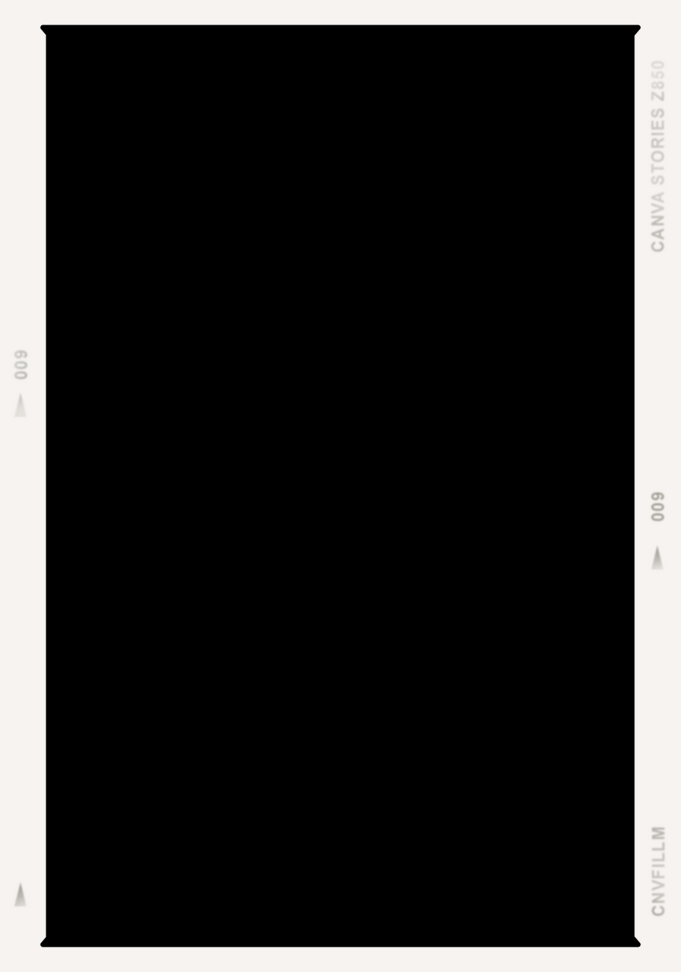


Problem statement - 1
Healthcare Practice Management System.
It helps in providing easy access to management facilities to the patient.
Similarly, doctors can easily provide the results of examinations to the patients. Ultimately, this acts as a bridge between patients and doctors and makes life easier and better as a whole.

Slide 3




Solution
We plan on working on such a project which is both intuitive and easy to use for the common man. This project will include facilities such as appointment scheduling, cost estimations, accessing of results of examinations, etc.

Slide 4


Key Features and Functionality
User-friendly UI with intuitive navigation.
Robust scheduling system which provides ease of access and quality of life.
Seamless bridge between doctor and patients.

Slide 5


Social impact
Proper work life balance.
Higher reach and convenience.
Higher reach and convenience.
Immediate access
Improved interaction between doctor and patients.

Slide 6


Revenue Model
The business model mainly includes SAAS (Subscription As A Service) where the hospital buys a subscription for the entire hospital and the users can access the app free of cost.
Additionally, the consideration of charging commission per major use can be made, but this does not have the same revenue ceiling as a SAAS model.

Slide 7



Technologies Used
Flutter/dart for frontend
Firebase as backend
Git for version control
VS code as code editor
Figma for UI/UX designing

Slide 8

The Team
Achyut Badyal
Thandaka Subhadeep
Bojedla Bhavani
22BCE7776
22BCE7248
22BCE9957

Slide 9


Thank You
HACKTOBER FEST

